Slide 1

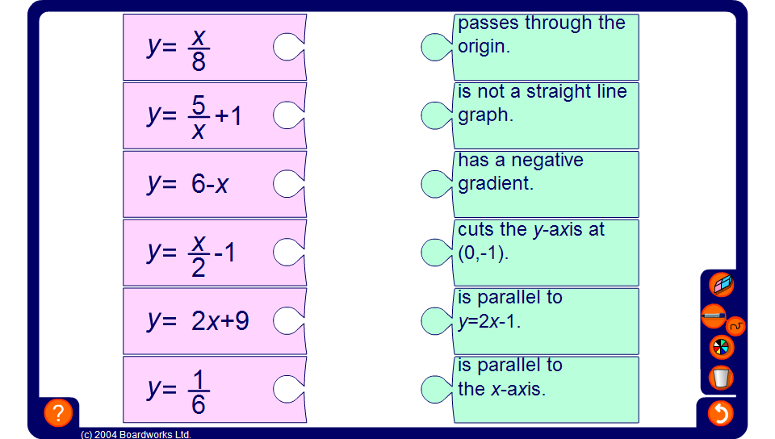


Matching statements
Notes:
Briefly discuss the graphs that would be produced by each of the equations on the left. Ask pupils what the gradient of each of the graphs would be and the y-intercept.
Note: one of the graphs is not linear because it contains x^{–1} and does not, therefore, have a constant gradient. Discuss the fact that this graph never crosses the y-axis (x = 0) because when x = 0 we would be dividing by 0 which is undefined.
Ask pupils to match each equation with the most appropriate statement by dragging matching pairs to fit together. Ask pupils to justify their choices with reference to the equation given.

